Slide 1

“E-Commerce Web Application”
Task - 2

Slide 2

SUNSTONE
Project Name : “ E-Commerce Web Application ”
An e-commerce website is one that allows people to buy and sell physical goods, services, and digital products over the internet rather than at a brick-and-mortar location. Through an e-commerce website, a business can process orders, accept payments, manage shipping and logistics, and provide customer service.
S.NO | LMS Username | Name | Batch
1 | @sakthivel3031 | Sakthivel | 8
2 | @erakashkumaryadav | Akash Kumar Yadav | 8
3 | @sharmakarnan | Sharma | 8
4 | @Tharun2192 | Tharun | 8

Slide 3

Taskꢀ-ꢀ2
CreateꢀUIꢀandꢀimplementꢀvariousꢀcomponentsꢀusingꢀreact
●
●
●
SplitꢀdesignꢀintoꢀcomponentsꢀandꢀHigherꢀorderꢀComponents
Defineꢀstructureꢀofꢀtheꢀcomponents
Setꢀtheꢀbasicꢀuiꢀcomponentsꢀwithꢀdummyꢀdata
IntegrateꢀtheꢀAPIsꢀtoꢀfrontendꢀtoꢀensureꢀtheꢀdynamicꢀfeatureꢀofꢀwebsite
●
●
●
●
●
Pointꢀbaseꢀapiꢀtoꢀtheꢀseversꢀbaseꢀurlꢀ
Designꢀapiꢀcallsꢀforꢀeachꢀelementꢀ
Handleꢀerrorsꢀinꢀtheꢀoutput
Renderꢀoutputꢀofꢀapisꢀtoꢀdifferentꢀlowꢀlevelꢀcomponents
Secureꢀcontentꢀofꢀpostꢀapisx
EvaluationꢀMetric:
● 100%ꢀCompletionꢀofꢀtheꢀaboveꢀtasks
Learning Outcome
▪
▪
▪
▪
DevelopingꢀcomplicatedꢀUIꢀusingꢀreactꢀcomponents
Usingꢀpropsꢀdrillingꢀandꢀcontextꢀtoꢀpassꢀvariables
Gettingꢀfamiliarꢀwithꢀdifferentꢀtypeꢀofꢀapiꢀcalls
Handlingꢀdifferentꢀinputꢀdata

Slide 4

Step-WiseꢀDescription
Setting up a React project with tools like Create React App.
Designing responsive and user-friendly UI components for product listings, cart, and checkout.
Integrating APIs to fetch product data and manage user accounts.
Implementing routing for different pages like product details and shopping cart.
Adding state management to handle user interactions and data updates.
Enhancing the user experience with features like search, filtering, and product reviews.
Ensuring responsive design and optimizing performance for a seamless shopping experience.
Summaryꢀofꢀyourꢀtask
Creating a frontend for an E-commerce website using React.js involves initiating a React Project, designing responsive user interfaces for product displays and cart management, and integrating APIs to handle product data and user accounts. It also entails routing to navigate between different pages, incorporating state management for user interactions and data updates, and improving the UX with features such as search, filters, and reviews. Additionally, ensuring responsive design and optimizing performance is vital for a smooth and efficient shopping experience.

Slide 5

AssessmentꢀParameter
SetupꢀProjectꢀforꢀCalculatorꢀ
project
Setupꢀbasicꢀstructureꢀofꢀtext-
editorꢀproject
Createꢀaꢀmainꢀcomponentꢀwithꢀtheꢀ
outerꢀstructureꢀofꢀcalculator
Check-List
Createꢀmainꢀcomponentꢀwithꢀ
allꢀfeatureꢀbuttons
Createꢀaꢀbuttonꢀcomponentꢀ
withꢀonꢀclickꢀhandler
Createꢀaꢀjsonꢀobjectꢀtoꢀstoreꢀ
dataꢀforꢀtextꢀeditor
Createꢀaꢀ`ꢀevaluateExpresion`ꢀ
functionꢀtoꢀevaluateꢀvalue
Pushꢀbothꢀcodeꢀtoꢀgithub

Slide 6
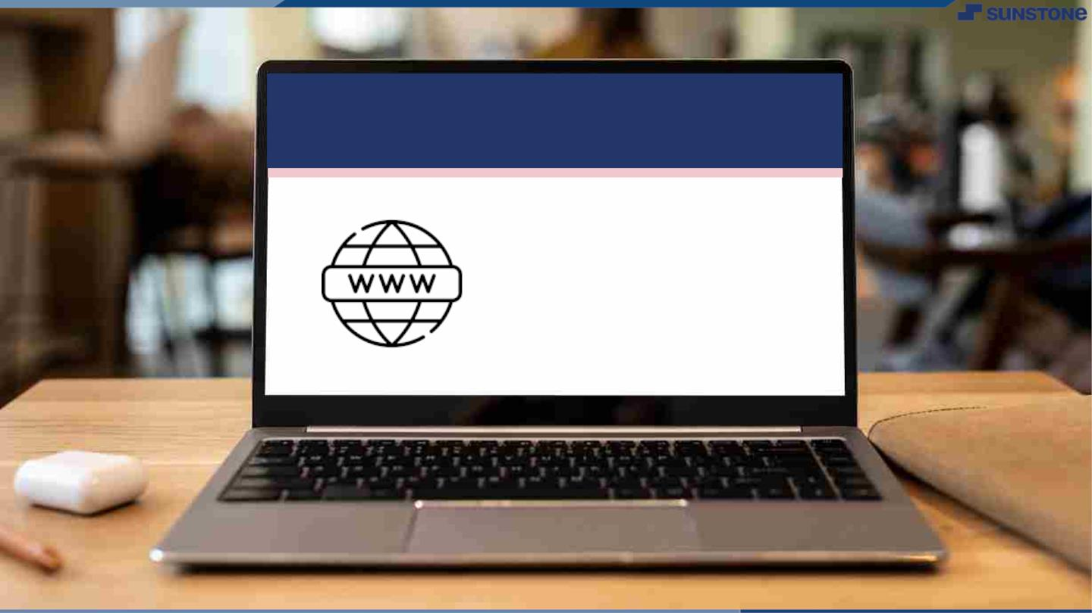
Submission Github
https://github.com/sakthivel3031/NM-AIT-GROUP8

Slide 7


